Slide 1


Slide 2


Participants
  Senior management
  Audit team
  Auditees
Sets the tone
Manage expectations
What to expect?

Slide 3
Confirm scope of audit
  Given in statement of scope of QMS
  Type of work done e.g. design, development, maintenance etc.
  Type of software developed e.g. client server applications, mainframe applications, ERP etc.
  Locations

Slide 4

“The audit team understands that the scope of the audit is - Design, development and maintenance of application software undertaken by the software development unit located at the ...address, ...city....”

Slide 5

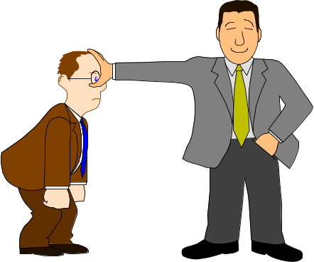
Confirm audit program
  Changes may be there
  Okay to swap, but with care
  Do not lose sight of focus
Flexibility is important !

Slide 6
Reiterate objectives of audit
  “Verify compliance to the documented
  Look at effectiveness as well
  Auditor’s view is different from tester’s view
  Make auditees feel at ease

Slide 7

Conduct of audit
  Where will audits be held?
  Method of logging NCs
  Major / Minor NCs : how will we handle?
  Any other information that we need to know?
Thank you!
Keep It Short and Sweet!

Slide 8


Slide 9

Choose location - convenient to auditee
Introductions
  Give feeling of comfort
Explain process
  “System, not individuals ”
Be friendly but polite
Suppress that yawn!

Slide 10

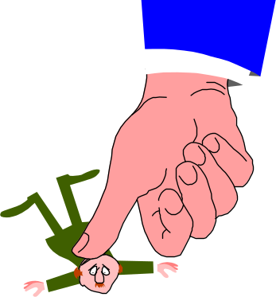
Keep control
Manage time
Be factual and objective
  However, use judgment
  Is there a problem?
Be professional
Very tempting to play GOD!!

Slide 11

Start off with Open Questions
  “How did you plan for this project?”
  “When did you prepare the test cases?”
LISTEN !
  Amazing how so few of us do this effectively!
Use SILENCE to your advantage

Slide 12

Do not get caught up in organizational dynamics - neutrality is important
Rephrase / reword, if necessary
Use “auditee” language to the extent possible
Closed questions
  Confirm facts / YES or NO answers

Slide 13

Etiquette in Auditee environment
  Norms of behavior
  Culture / Conventions
Auditee territory
Nervousness / Defensiveness
Physical disabilities / Potential health problems

Slide 14

Pulling rank / authority
Hostility
Stoicism
Diversions
Organizational conflicts
Volunteered information
Wrong information

Slide 15

Breaking Bad news:
  Empathize
    How does it feel to be in his place??
  Do not judge the person
    Our findings relate to the system or process, not the individual
  Give positive strokes first
  May talk of integrity and fairness of approach

Slide 16

  Show him how it can help
    If it can’t help, then why do it?
    Talk of consequences
  Be straightforward in your approach
    Do not be apologetic
    Do not mollycoddle
  Above all, be sincere and true to your work

Slide 17

  Body language
  Don’t ask leading questions
  Don’t Assume
  Knowledge of internal situations should be used with caution

